Slide 1
Lecture: Graph Traversals (BFS, DFS)

Slide 2
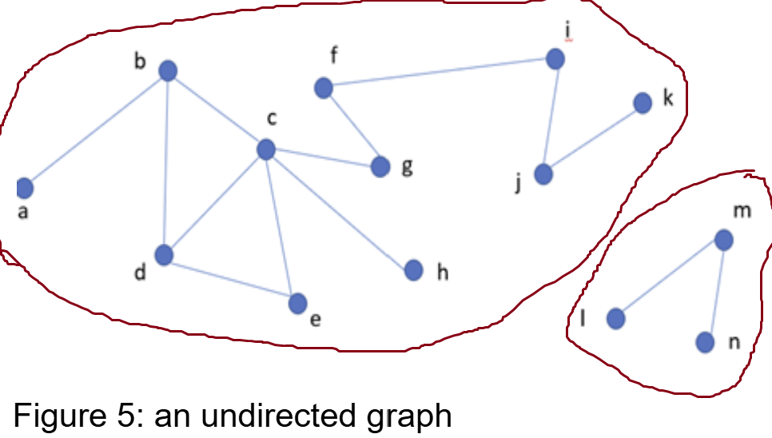
Graph representation (Recap)
Graphs vs Trees: Unlike trees, graphs may lack a root node, making it impossible to traverse all vertices from a single starting point, especially in disconnected graphs. Solution for Graph Representation: In typical graph representations, all vertices and edges are explicitly provided to ensure the entire graph structure is accessible, regardless of connectivity.
Graph representation Ch 22.1

Slide 3
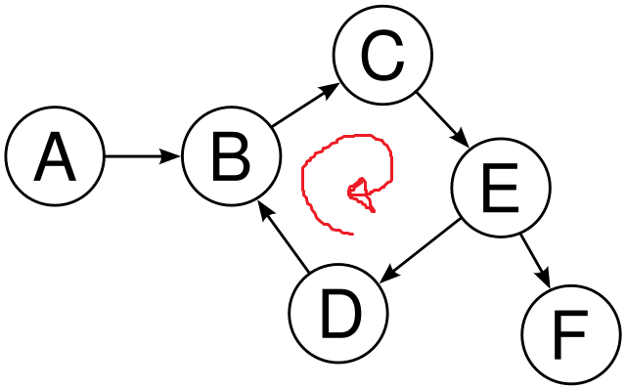
Graph traversals
Graph Traversal Purpose:
Given a graph G=(V,E) and a starting vertex s
Visit each vertex v∈V exactly once
Difference from Trees:
Graphs may contain cycles → risk of infinite recursion.
Graphs may be disconnected → not all vertices are reachable from one source.

Slide 4
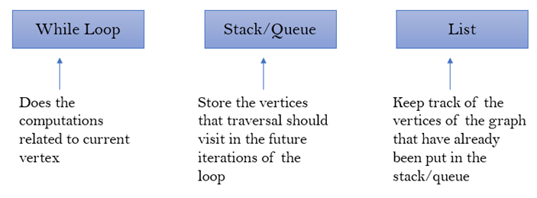
Graph traversals
Difference from Trees:
Graphs may contain cycles → risk of infinite recursion.
Graphs may be disconnected → not all vertices are reachable from one source.
Solution: Use while loops, a stack/queue, and a visited list to track progress.

Slide 5
Graph traversals [general structure]
Traversal Process:
Insert starting vertex into stack/queue and visited list.
Loop until stack/queue is empty:
Remove vertex from stack/queue.
Process the vertex.
Add unvisited neighbors to stack/queue and visited list.
Disconnected Graphs: After traversal, check for unvisited vertices and repeat from them.

Slide 6
Graph traversals
Two common graph traversal algorithms
Breadth-First Search (BFS) Start with the source vertex Gives information about all vertices and edges Explores the breadth first, visiting all neighbors at the current level before moving to the next. Fan out to explore all neighbors at the current depth before moving deeper Uses Queue (FIFO) | Depth-First Search (DFS) Start with the source vertex Gives information about all vertices and edges Recursively visit each neighbor (Recursive stack) DFS goes deep, exploring as far as possible along each branch before backtracking. Backtrack only when no further choices are available Similar to pre-order tree traversal Uses Stack(LIFO)

Slide 7
Node Selection Rules in Traversal
Alphabetical options: Choose the alphabetically closest.
Numerical options: Follow stated order (ascending/descending).
No order given: Select any option.

Slide 8
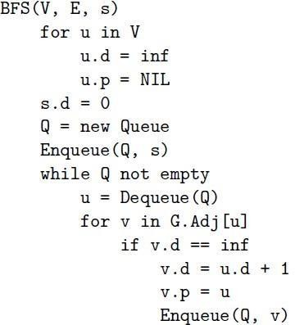
Breadth first search (BFS)

Slide 9
Breadth first search (BFS)
Information during traversal
color [u]: the color of each vertex visited
white: undiscovered
gray: discovered but not finished processing
black: finished processing
π[u ] or p[u ]: the predecessor of u
d [u ]: the distance from source

Slide 10
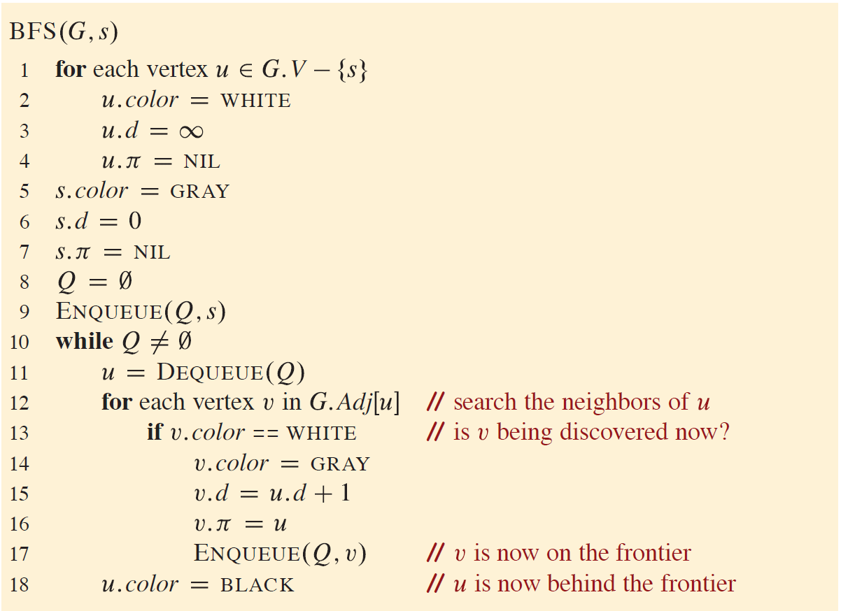
Breadth first search (BFS) another version

Slide 11
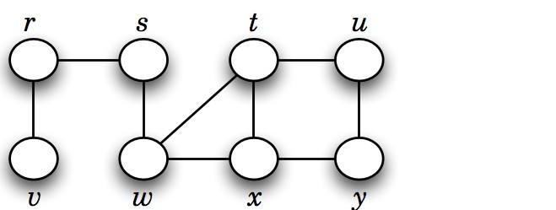
Basic idea behind breadth first search (BFS)
Given a graph G = (V , E ), and a distinguished vertex s, systematically visit each vertex v ∈ V that is reachable from s.
Builds a BFS tree over the graph starting from a source vertex.

Slide 12
Breadth first search (BFS)

Slide 13
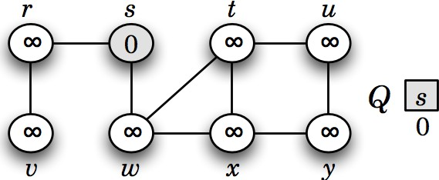
Breadth first search (BFS)

Slide 14
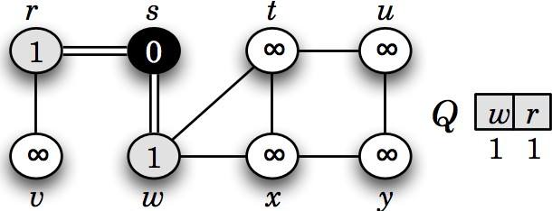
Breadth first search (BFS)

Slide 15
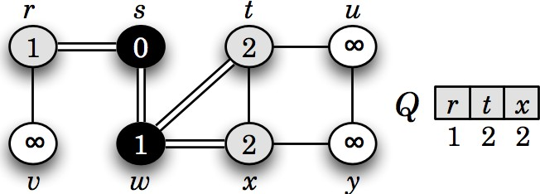
Breadth first search (BFS)

Slide 16
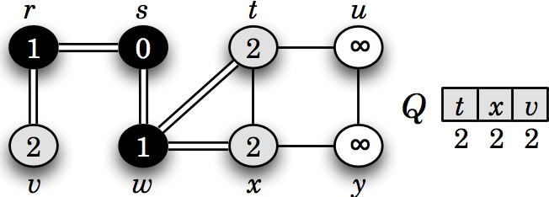
Breadth first search (BFS)

Slide 17
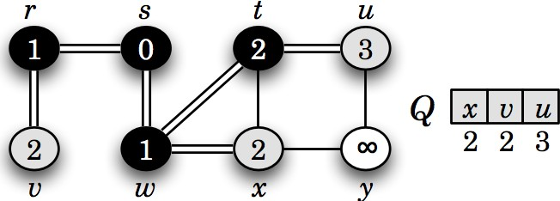
Breadth first search (BFS)

Slide 18
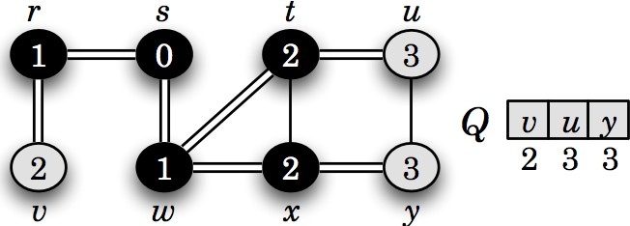
Breadth first search (BFS)

Slide 19
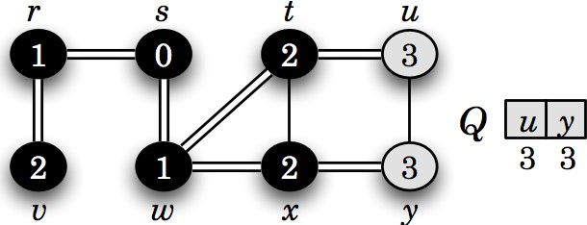
Breadth first search (BFS)

Slide 20
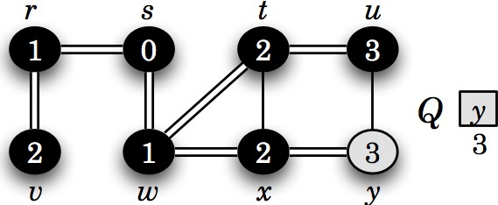
Breadth first search (BFS)

Slide 21
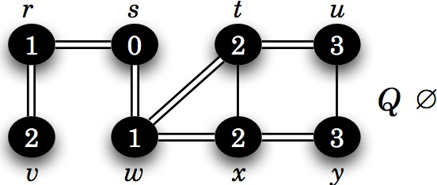
Breadth first search (BFS)

Slide 22
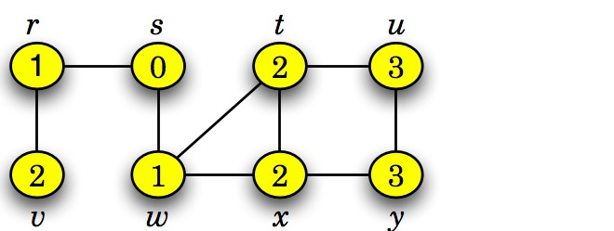
Breadth first search (BFS)
This graph G = (V , E ) is connected, since BFS visits all vertices v ∈ V starting from s.
BFS also finds the shortest path (fewest edges) from s to any other vertex t.

Slide 23
Breadth-first search - Analysis
Run-time
Set-up/initialization is O (V )
Each vertex is enqueued at most once
Enqueuing is O(V )
Each vertex is dequeued at most once
Dequeuing is O(V )
Main loop
Each vertex is dequeued once as u
For given u, we run over all adjacent v, i.e., all edges (u, v) starting at u
In total, we run over each edge once
The nested loop is just executed O(E) times
Total runtime O (V + E )

Slide 24
Breadth first search (BFS)-Analysis
BFS(G, s) // G = (V, E), s is the source vertex 1. for each vertex u in V: 2. u.d = ∞ // Set distance to infinity 3. u.p = NIL // Set parent to NIL 4. s.d = 0 // Set the distance of the source vertex to 0 5. Q = new Queue // Initialize an empty queue 6. Enqueue(Q, s) // Enqueue the source vertex 7. while Q is not empty: 8. u = Dequeue(Q) // Remove the front vertex from the queue 9. for each vertex v in Adj[u]: 10. if v.d == ∞: // If vertex v has not been visited 11. v.d = u.d + 1 // Set the distance of v 12. v.p = u // Set parent of v to u 13. Enqueue(Q, v) // Enqueue vertex v

Slide 25
Breadth first search (BFS)-Analysis
BFS(G, s) // G = (V, E), s is the source vertex 1. for each vertex u in V: // O(V)--for all vertices 2. u.d = ∞ 3. u.p = NIL 4. s.d = 0 // O(1) 5. Q = new Queue // O(1) 6. Enqueue(Q, s) // O(1) 7. while Q is not empty: 8. u = Dequeue(Q) // O(1) 9. for each vertex v in Adj[u]: // O(E) =degree(u) [no of edges connected], for undirected each edge visited twice so it will be O(2E) 10. if v.d == ∞: // O(1) 11. v.d = u.d + 1 // O(1) 12. v.p = u // O(1) 13. Enqueue(Q, v) // O(1) Total time complexity: O(V + E) when using adjacency list
O(E)

Slide 26
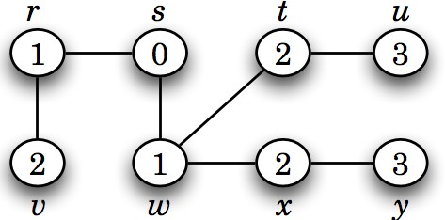
Breadth first search (BFS) Tree
A BFS tree is a tree formed during BFS that shows the shortest paths (in terms of edges) from the source vertex to all other reachable vertices in the graph.

Slide 27
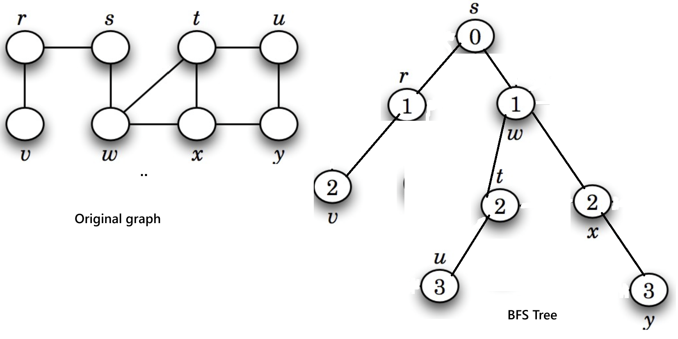
Breadth first search (BFS) Tree

Slide 28
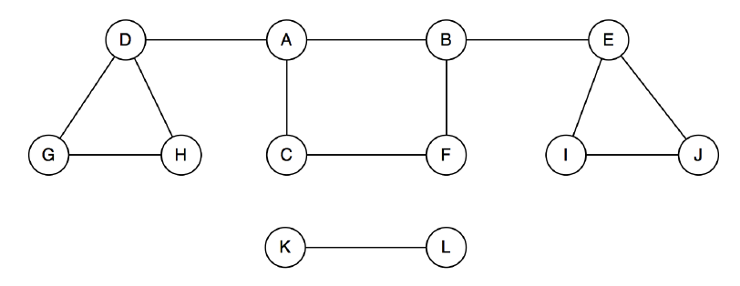
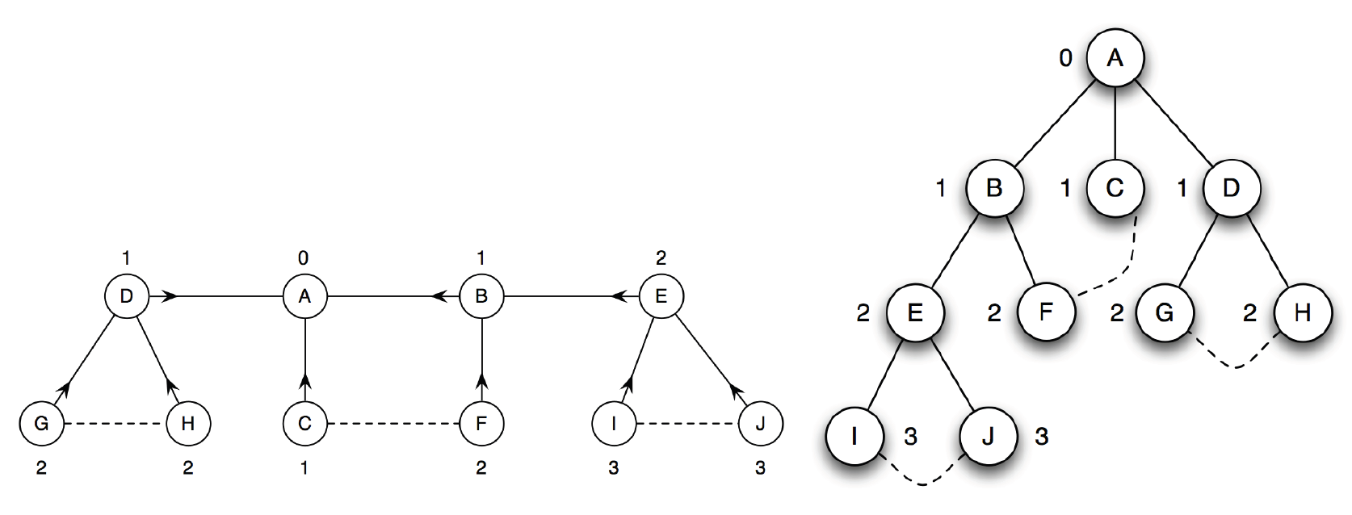
Breadth first search (BFS) Forest- 2 trees

Slide 29
Breadth first search (BFS) Tree
A single BFS from vertex A only visits vertices in its connected component.
Vertices K and L are not visited if they are not reachable from A.
To visit all vertices, perform BFS from each unvisited vertex in the graph.
This approach identifies all connected components in the graph.

Slide 30
Breadth first search (BFS)
BFS(G, s) // G = (V, E), s is the source vertex 1. for each vertex u in V: 2. u.d = ∞ // Set distance to infinity 3. u.p = NIL // Set parent to NIL 4. s.d = 0 // Set the distance of the source vertex to 0 5. Q = new Queue // Initialize an empty queue 6. Enqueue(Q, s) // Enqueue the source vertex 7. while Q is not empty: 8. u = Dequeue(Q) // Remove the front vertex from the queue 9. for each vertex v in Adj[u]: 10. if v.d == ∞: // If vertex v has not been visited 11. v.d = u.d + 1 // Set the distance of v 12. v.p = u // Set parent of v to u 13. Enqueue(Q, v) // Enqueue vertex v

Slide 31
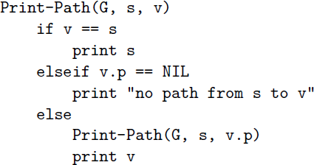
Breadth-first search - Printing a path from s to v
After running Breadth-First Search (BFS), we get a BFS tree.
This tree shows how each vertex was reached from the source.
The predecessor info (u.π) stores the previous node on the path.
Using this info, we can easily reconstruct or print the path from the source s to any node v.

Slide 32
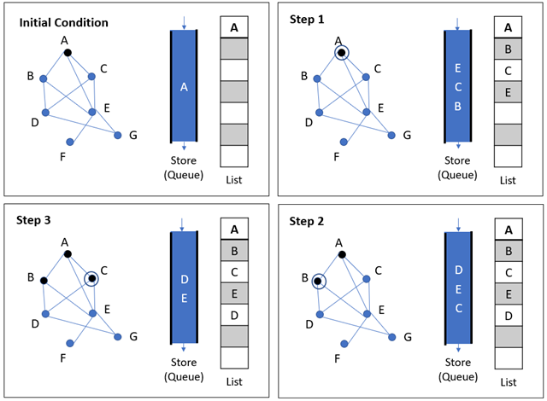
Breadth-first search - Example
Source: https://www.tutorialspoint.com/data_structures_algorithms/

Slide 33
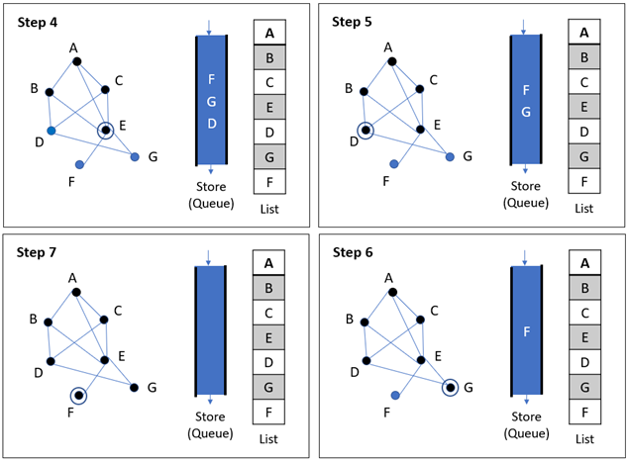
Breadth-first search - Example
Source: https://www.tutorialspoint.com/data_structures_algorithms/

Slide 34
Applications of BFS
Shortest Path (Unweighted Graph): Finding the shortest path in undirected or directed unweighted graphs using level-order traversal.
Bipartiteness Check: Verifying if a graph can be divided into two disjoint sets using two-coloring.
Cycle Detection (Undirected Graph): Detecting cycles by checking for back edges during traversal.
Graph Connectivity: Checking whether all vertices are reachable from a given starting point. Implementation will be covered in CSE221

Slide 35
Depth-first search
Starts from an initial vertex.
Recursively visits each adjacent vertex.
Strategy to search deeper into the graph, unlike BFS which fans out.
It explores edges from the most recently discovered vertex with unexplored edges.
After all edges of a vertex are explored, it backtracks to its parent.
If any vertices remain undiscovered, DFS starts again from one of them.
DFS produces a depth-first forest (collection of DFS trees).

Slide 36
Depth-first search
Information during traversal
color [u]: the color of each vertex visited
white: undiscovered
gray: discovered but not finished processing
black: finished processing
π[u ] or p[u ]: the predecessor of u
d [u ]: the discovery time (or hops from the start)
f [u]: the finish time – when processing of u and all its descendants have finished.

Slide 37
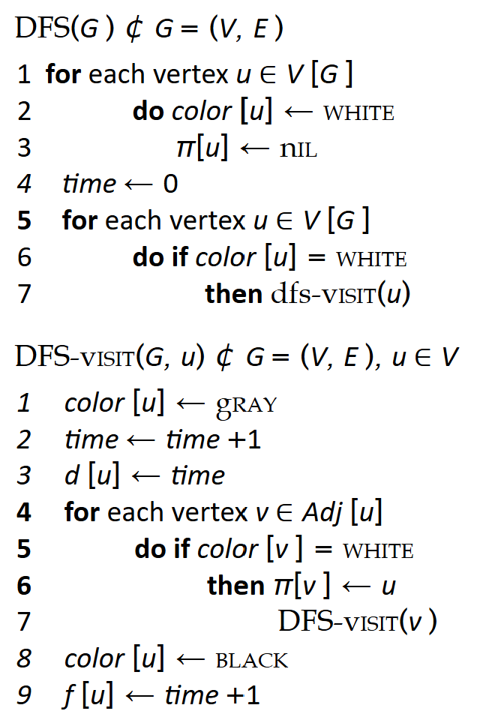
Depth-first search

Slide 38
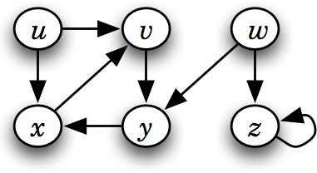
Depth-first search

Slide 39
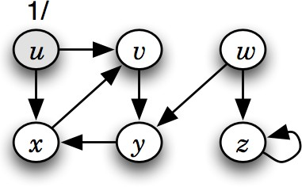
Depth-first search

Slide 40
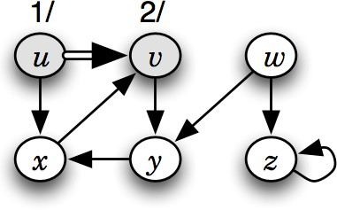
Depth-first search

Slide 41
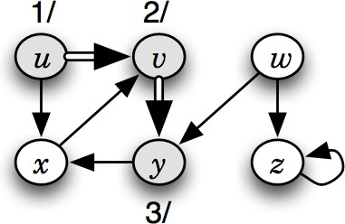
Depth-first search

Slide 42
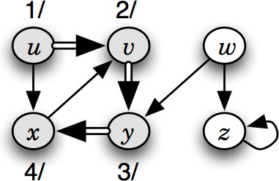
Depth-first search

Slide 43
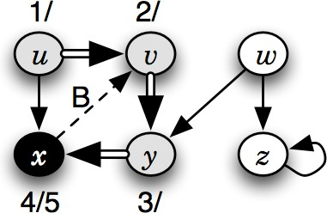
Depth-first search

Slide 44
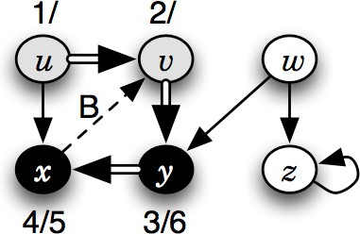
Depth-first search

Slide 45
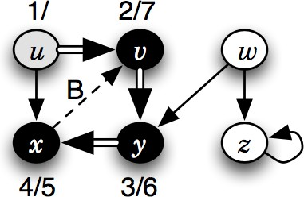
Depth-first search

Slide 46
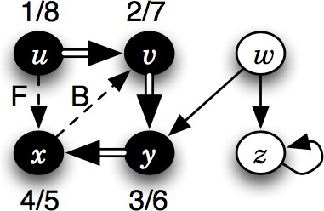
Depth-first search

Slide 47
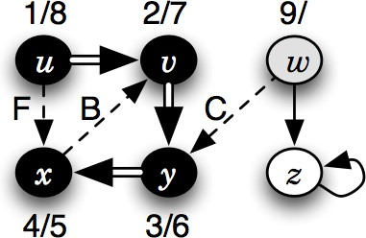
Depth-first search

Slide 48
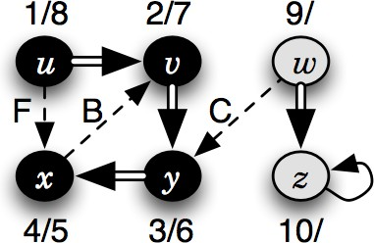
Depth-first search

Slide 49
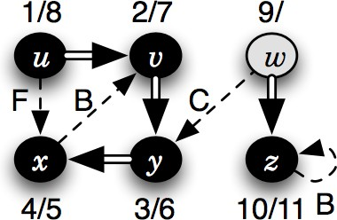
Depth-first search

Slide 50
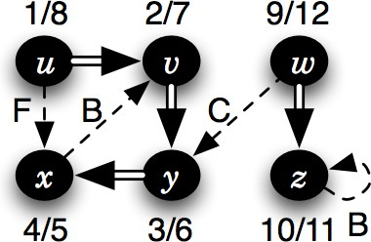
Depth-first search

Slide 51
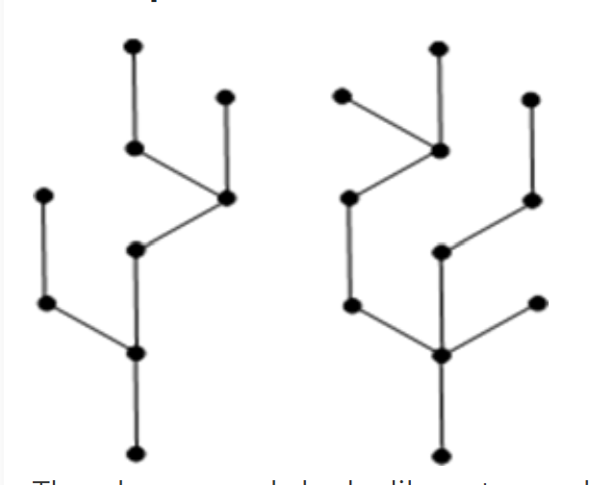
Forests (Recap from tree terminologies)
Forest: Forest is a disjoint collection of trees
The graph on left looks like a two sub-graphs but it is a single disconnected graph. There are no cycles in the above graph. Therefore it is a forest.
Trees Ch B.5, 10.4, 12.1

Slide 52
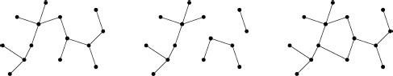
Trees and forests (Recap from tree terminologies)
Image:²
²Cormen, Leiserson, Rivest, Stein. Introduction to Algorithms, 3rd edition, MIT Press, 2009
Trees Ch B.5, 10.4, 12.1

Slide 53
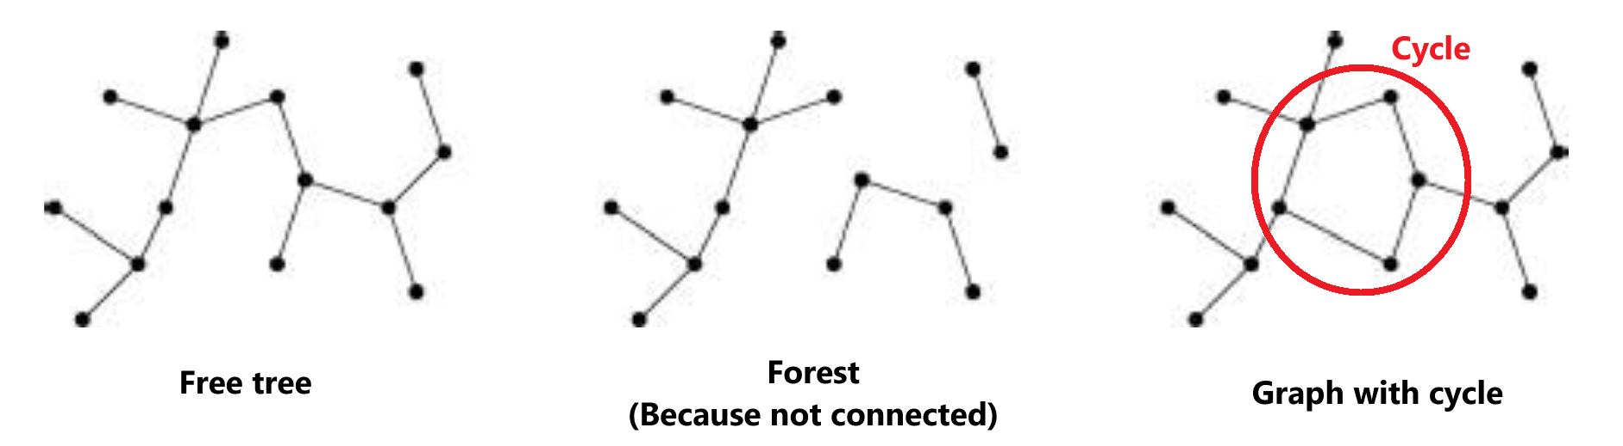
Trees and forests (Recap from tree terminologies)
Image:²
²Cormen, Leiserson, Rivest, Stein. Introduction to Algorithms, 3rd edition, MIT Press, 2009
Trees Ch B.5, 10.4, 12.1

Slide 54
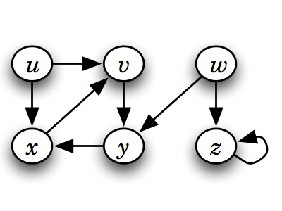
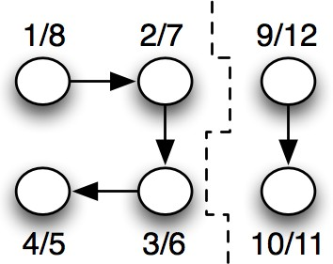
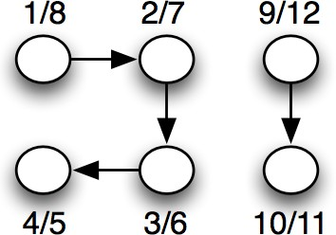
Depth-first search tree or forest

Slide 55
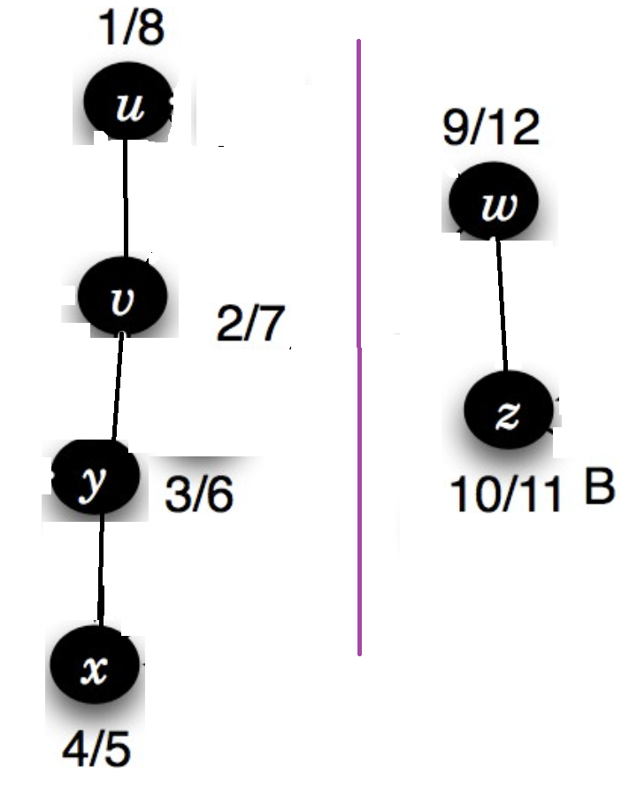
Depth-first search tree or forest

Slide 56
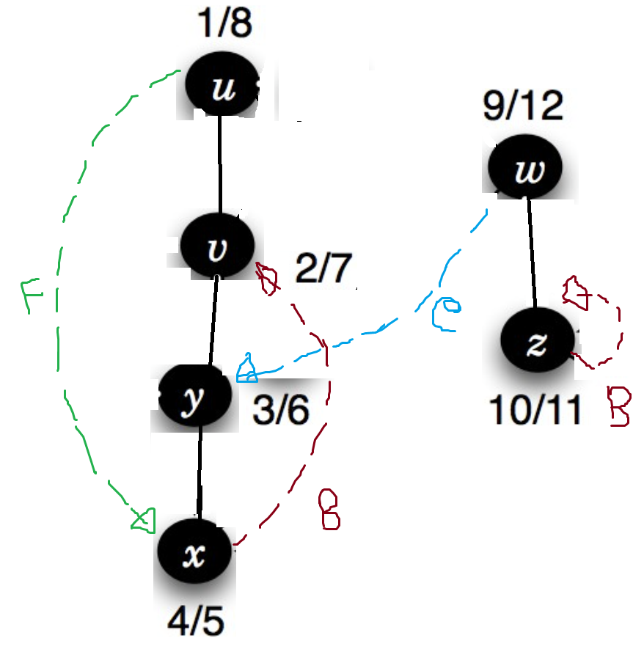
Depth-first search tree or forest

Slide 57
Depth-first search Edges (Not needed for CSE220)
DFS introduces an important distinction among edges in the original graph:
Tree edge: encounter new (white) vertex
Back edge: from descendent to ancestor
Forward edge: from ancestor to descendent
Cross edge: between a tree or subtrees
Note: tree & back edges are important; most algorithms don’t distinguish forward & cross

Slide 58
Depth-first search Edges (Not needed for CSE220)
Application of these 4 edges:
Tree edge:Connects a vertex to a newly discovered vertex, building the DFS tree.
Back edge: Points to an ancestor, identifying a cycle in the graph.
Forward edge: helps in depth classification, topological sorting, and identifying strongly connected components (SCCs).
Cross edge: Connects nodes in different DFS branches or subtrees. Details of there edges will be covered in CSE221

Slide 59
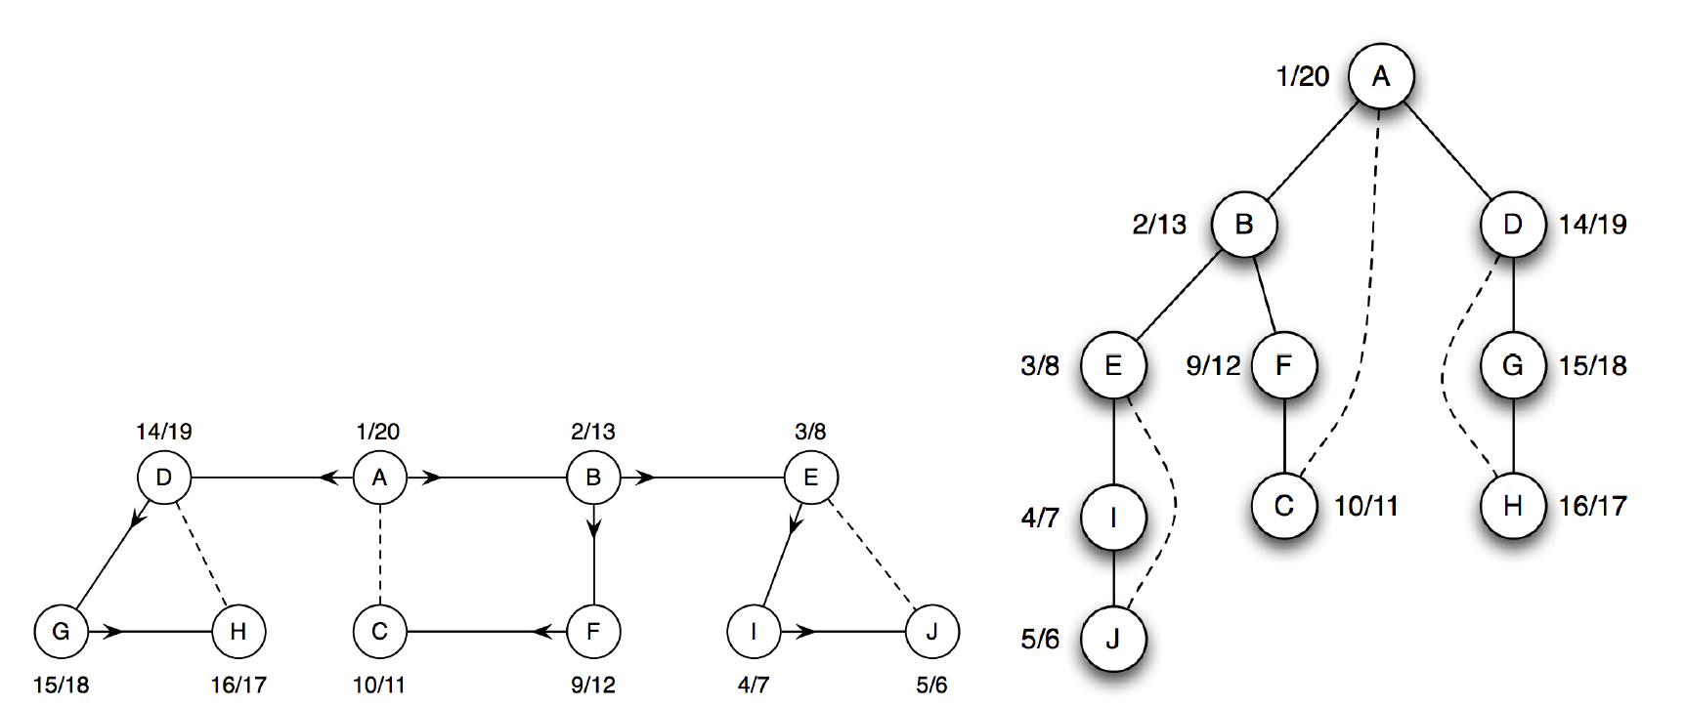
Depth-first search tree or forest

Slide 60
Depth-first search tree or forest
A single BFS/DFS from vertex A visits only its connected component.
Vertices like K and L are not visited if they are not reachable from A.
To visit all vertices, perform BFS/DFS from each unvisited vertex.
This ensures traversal of the entire graph, including all disconnected components.

Slide 61
Depth-first search

Slide 62
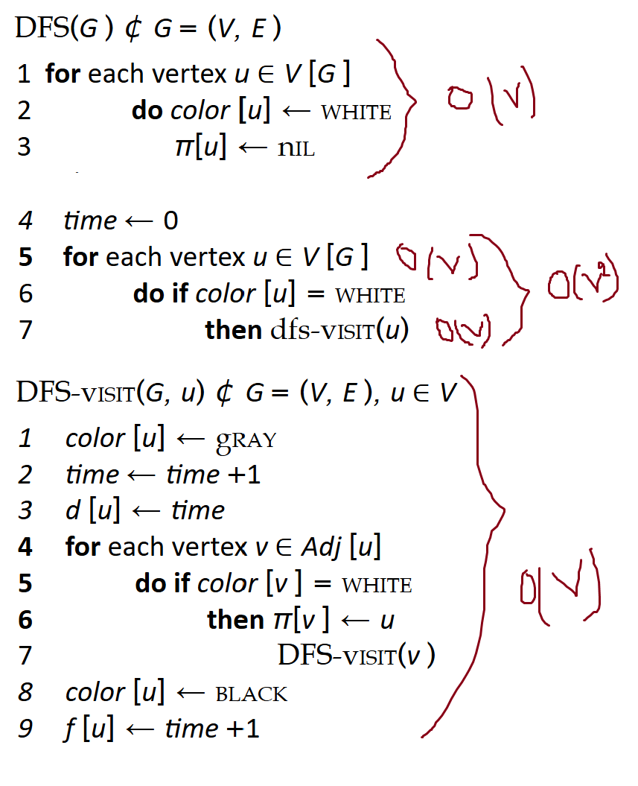
Depth-first search- Analysis
Running time: O(V²)
DFS_Visit is called on each vertex
The loop over Adj[] can run up to |V| times per vertex in the worst case How many times will DFS_Visit() actually be called?

Slide 63
Depth-first search - Analysis
Run-time
Each vertex and each edge is examined once
So, total time = O(V + E) instead of O(V²)
20/23

Slide 64
Depth-first search- Analysis
But often DFS is more efficient:
DFS_Visit() is called once per vertex → O(V)
Each edge is explored once (directed, O(E) ) or twice (undirected, O(2E)) → O(E)
So, total time = O(V + E) instead of O(V²)

Slide 65
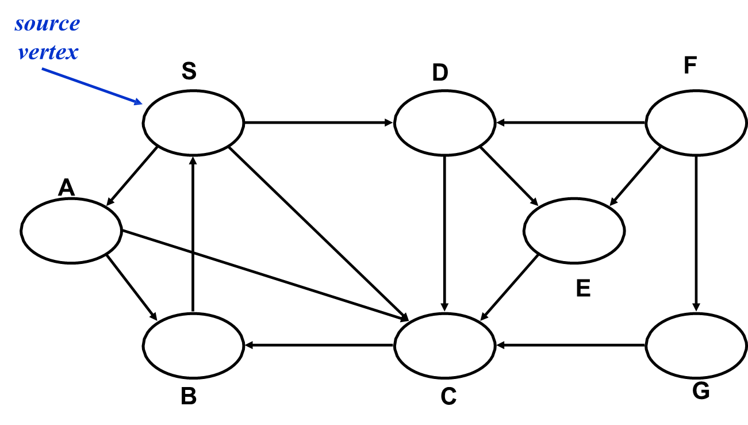
Depth-first search
20/23

Slide 66
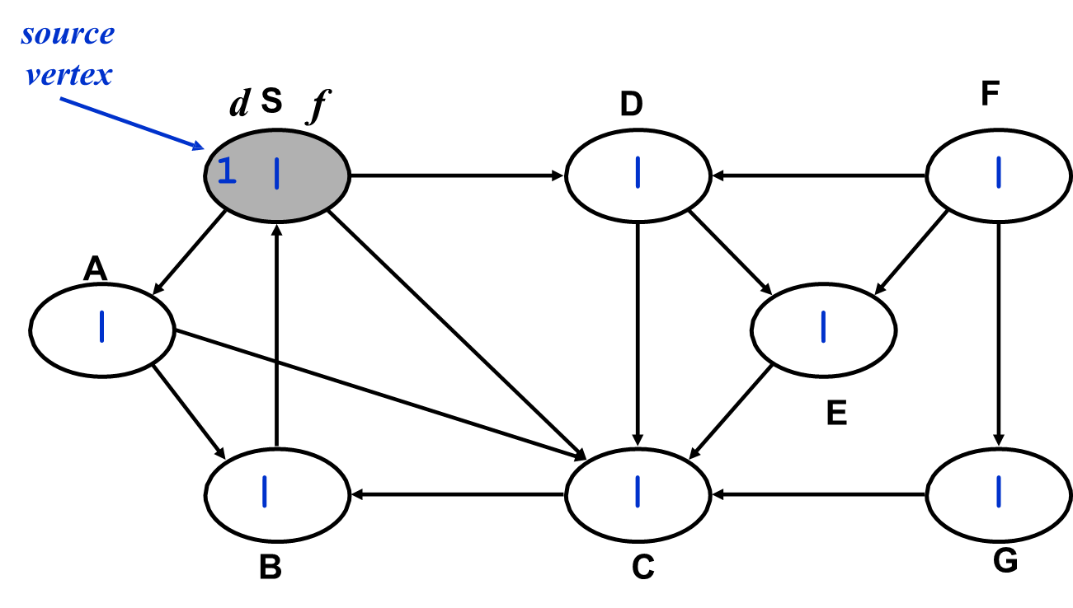
Depth-first search
20/23

Slide 67
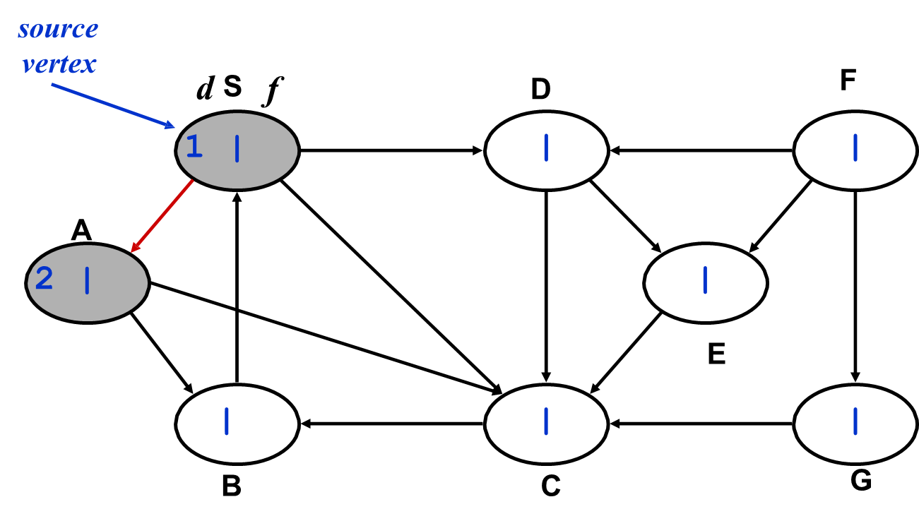
Depth-first search
20/23

Slide 68

Depth-first search
20/23

Slide 69

Depth-first search
20/23

Slide 70

Depth-first search
20/23

Slide 71

Depth-first search
20/23

Slide 72

Depth-first search
20/23

Slide 73

Depth-first search
20/23

Slide 74

Depth-first search
20/23

Slide 75

Depth-first search
20/23

Slide 76

Depth-first search
20/23

Slide 77

Depth-first search
20/23

Slide 78

Depth-first search
20/23

Slide 79

Depth-first search
20/23

Slide 80

Depth-first search
20/23

Slide 81

Depth-first search
20/23

Slide 82

Depth-first search Example
Source: https://www.tutorialspoint.com/data_structures_algorithms/

Slide 83

Depth-first search Example
Source: https://www.tutorialspoint.com/data_structures_algorithms/

Slide 84
Applications of Depth-first search
Topological Sorting: Ordering vertices in a directed acyclic graph (DAG).
Strongly Connected Components (SCC): Identifying subsets of vertices where every vertex is reachable from every other vertex.
Cycle Detection: Detecting cycles in directed graphs using back edges.
Path Finding: Finding paths between vertices in a graph.
Solving puzzles/mazes: Like the Knight’s Tour problem or Sudoku. Implementation will be covered in CSE221
20/23

Slide 85
Adjacency list-based BFS and DFS are optional; however, please ensure you review the adjacency matrix-based implementations.

Slide 86
The End

